Slide 1
Coupon Purchase Prediction
Team BruteForce - November 6, 2021
CSCE 5300.002

Slide 2

Team Members
Prathima Bommannagari
Ganesh Bommisetty
Shasidhar Jampana
Akhil Kata
Harshada Pol
Siva Kumar Sri Sai Pulavarthy
Dan Waters

Slide 3
Agenda
Introduction
Business Understanding
Problem Class
Assumptions
Evaluation Criteria
Data
Data Source
Preprocessing
Exploratory Data Analysis
Solution
Baseline
Logistic Regression (predict based on browsing history)
Cosine similarity (compare purchased coupons with test set coupons)
Decision Forest and Gradient Boosted Trees
Comparisons
Results & Conclusion
Future Enhancements
Q&A

Slide 4
Introduction

Slide 5
Business Understanding
Recruit Ponpare (a website like Groupon) partners with businesses to sell discounted services to end customers via prepaid coupons.
Example: $25 birthday cake for $10 at BruteForce Bakery
Local business
Coupon broker
End users
Uses coupons as a marketing tactic to drive business with pre-paid discount sales
Lists coupons from local businesses to a captive audience of coupon buyers for a fee
Everyday people engage with local businesses, thanks to the coupon marketplace

Slide 6
Project objective:
Predict which 10 coupons a user is most likely to purchase from 6/24/2012 - 6/30/2012

Slide 7
Problem Class
Recommender systems are usually supervised learning tasks:
The user has entered information about what they like (purchases, reviews, ratings, etc), giving us labeled training data. We provide one such approach.
There are also unsupervised approaches…
K-means clustering to find similar coupons to ones already purchased.
And algorithmic approaches…
such as cosine similarity evaluation and collaborative filtering.
In our project, we consider three general approaches:
supervised learning with hybrid collaborative filtering (logistic regression)
decision forests & gradient boosted trees
hybrid collaborative filtering using cosine similarity

Slide 8
Assumptions
Working within the scope of the Recruit Ponpare Kaggle competition
Data, problem framing are provided
The data we have is all that is available (no other datasets to include)
Fixed timeframe for browsing & purchases for train and test periods

Slide 9
Understanding the Dataset

Slide 10
Dataset Overview
Our data comes from a Kaggle competition called “Coupon Purchase Prediction,” which contains data from Japanese joint coupon website Ponpare.jp.
The data set contains:
One year of historical coupon transaction data (July 2011 to June 2012)
22,873 users
Coupon details (genre, location, % discount, price)
Coupon purchase history
Browsing history
Prefecture locations (names and lat/lon coordinates)
Test sets for the week of 24 June 2012 - 30 June 2012 are held-out.

Slide 11
Dataset Challenges
Some columns have values in Japanese, requiring a translation step in the preprocessing pipeline
Many NaN values - some are meaningful, others not
For example, NaN in a user’s withdrawal date means they are active on the website
But NaN for Prefecture means the user has not completed their profile
Several tables to join together

Slide 12
Tables
We have multiple tables to consider in our project:
User List
Coupon Listings (training & test data sets)
Coupon Transaction History (training only)
Coupon Areas (training & test data sets)
Coupon Visits (training only)
Prefecture Locations
An entity-relationship diagram is available in the appendix.

Slide 13
Exploratory Data Analysis

Slide 14
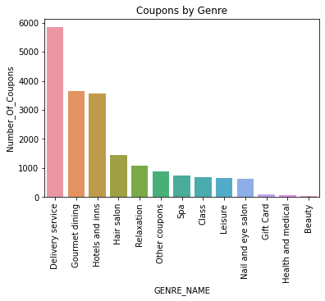
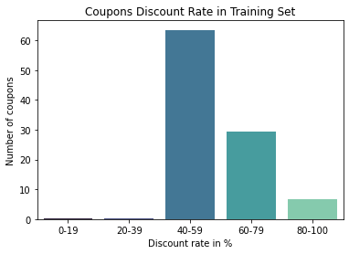
Analysis: Coupon List (Genre & Discount Rate)

Slide 15
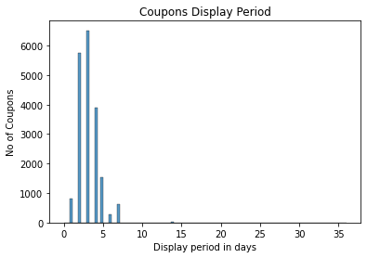
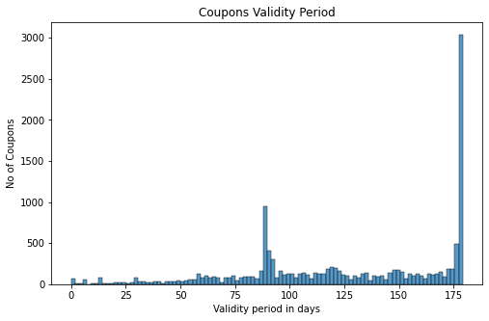
Analysis: Coupon List (Display & Validity Periods)

Slide 16
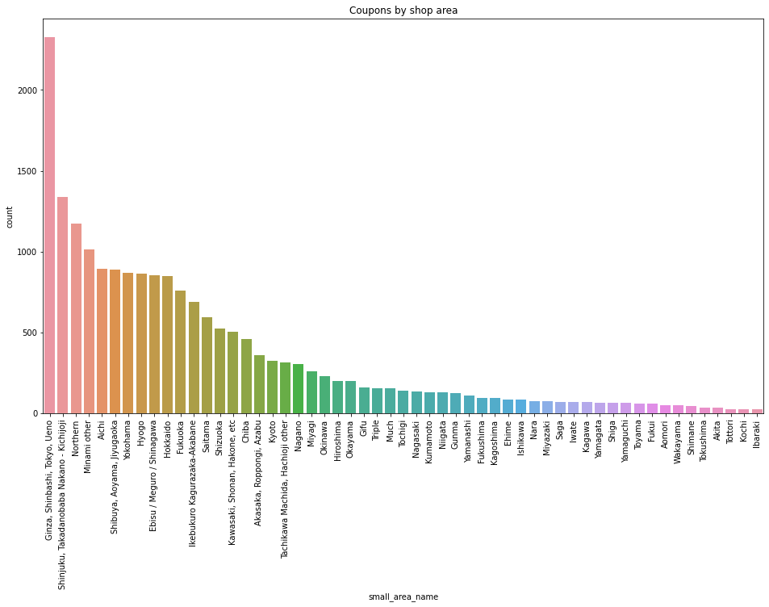
Coupons by Small Area

Slide 17
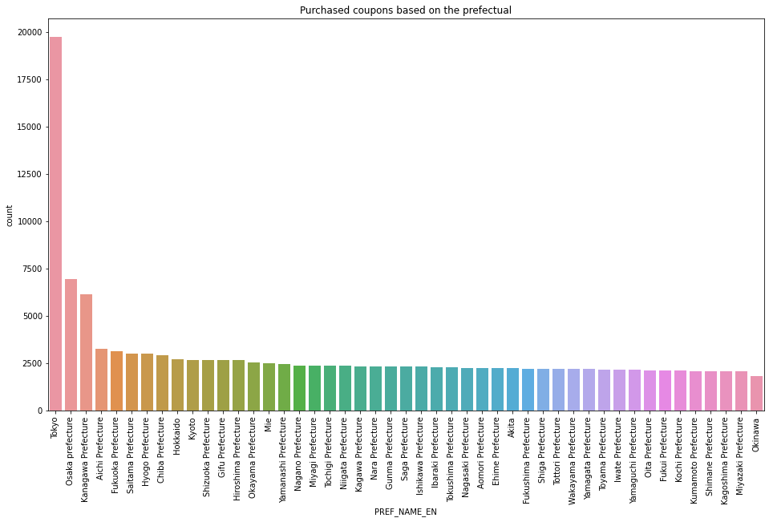
Coupons by Prefecture

Slide 18
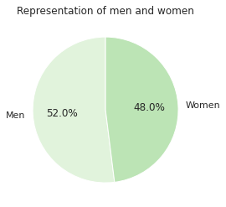
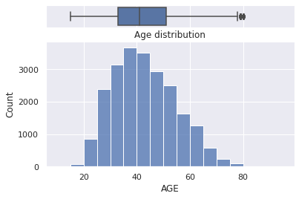
Analysis: User List
22,783 records
Columns
REG_DATE | Registration date (datetime)
SEX_ID | M or F (categorical)
AGE | numeric
WITHDRAW_DATE | Date of unregistration (if applicable)
PREF_NAME | Prefecture in Japan where user is located (Japanese)
USER_ID_hash | Unique user ID
= potential demographic targeting feature

Slide 19
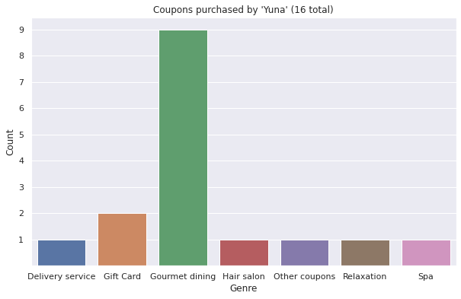
Individual User Persona (“Yuna”)
About “Yuna”
Female, age 32
Lives in Tokyo
Really likes food
Only bought one coupon outside of Tokyo

Slide 20
Solutions

Slide 21
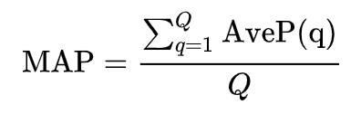
Evaluation Criteria - Mean Average Precision @ 10
Mean Average Precision (k=10) is the evaluation metric Kaggle uses to judge entries on its test set for this competition, so we will be optimizing MAP@10. The best public MAP score is 0.01268.
mAP is the mean of the average precisions of the top k classes (in this case, top 10 coupons predicted for a user).
Other evaluation metrics may be used during training monitoring.
Glossary
Q number of classes, equal to k for us
q individual class being averaged
AveP() average precision for a single class
Source: “Mean average precision.” Wikipedia, https://en.wikipedia.org/wiki/Evaluation_measures_(information_retrieval)#Mean_average_precision

Slide 22
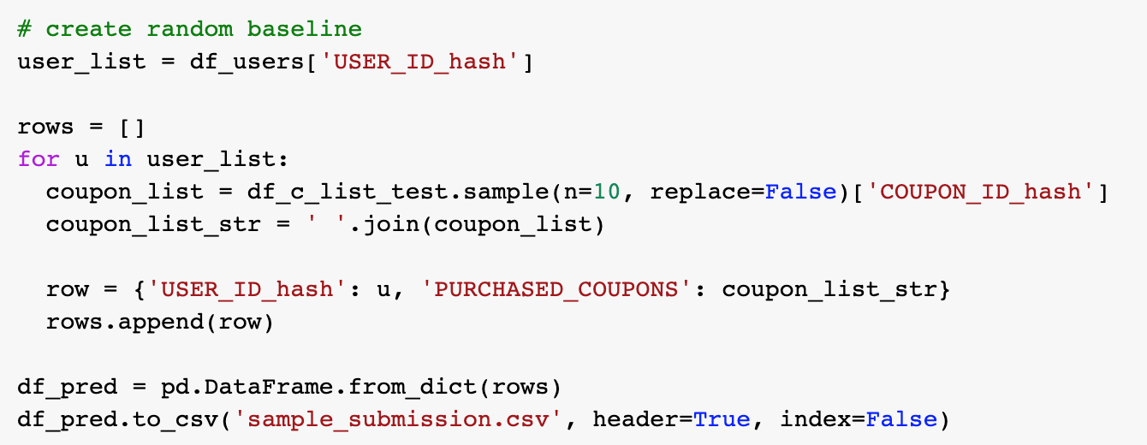
Baseline Solution
Random Sampling (MAP@10 result = 0.00051)
Algorithm:
For each user, randomly select 10 coupons from the test set and recommend them.
Surely we can do better than this!

Slide 23
Solution #1: Logistic Regression on Browsing Data
Step 1: Join and preprocess raw, anonymized training data
Browsing data + user data, joined on USER_ID_hash
Join the above to coupon details on COUPON_ID_hash
Create age ranges instead of continuous ages (for user-based collaborative filtering)
Convert sex_id from m/f to 0/1
Resulting training fields:
age_group | sex | discount_rate | discount_price | user_prefecture | coupon_prefecture | genre | capsule_text | purchase_flag
training features
target

Slide 24
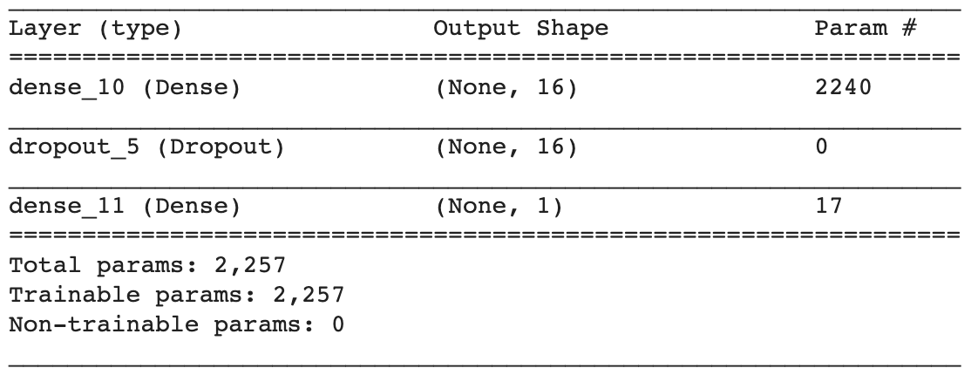
Solution #1: Logistic Regression on Browsing Data
Step 2: One-hot encode the categoricals (resulting in 139 input columns)
Step 3: Build and train the model - simple dense NN with one hidden layer and sigmoid activation
Hardware-accelerated training time: ~55 min
Inference time (mapping coupons to users): ~1 hour
Validation precision & recall: 0.0 - What?
Kaggle MAP@10 score on test set: 0.00028
This is worse than random sampling… why?

Slide 25
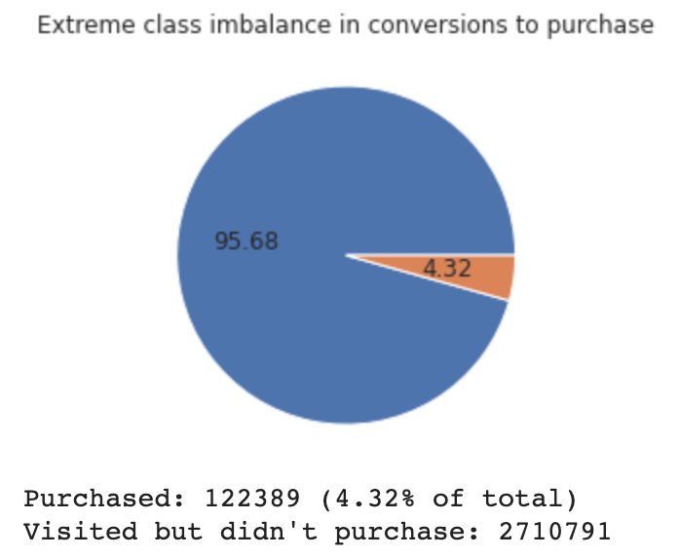
Solution #1: Logistic Regression on Browsing Data
For browsing data, the positive class (‘the user bought something’) is extremely underrepresented!
We will take this same approach, but:
Introduce feature scaling (fit on training set)
One-hot encode additional categoricals (146 cols)
Use stratified sampling in train_test_split
Initialize the bias to np.log([pos/neg])
Implement early stopping
Compute the class weights so that the model pays more attention to the purchases
For a comprehensive tutorial on dealing with imbalanced classes, see:
https://www.tensorflow.org/tutorials/structured_data/imbalanced_data

Slide 26
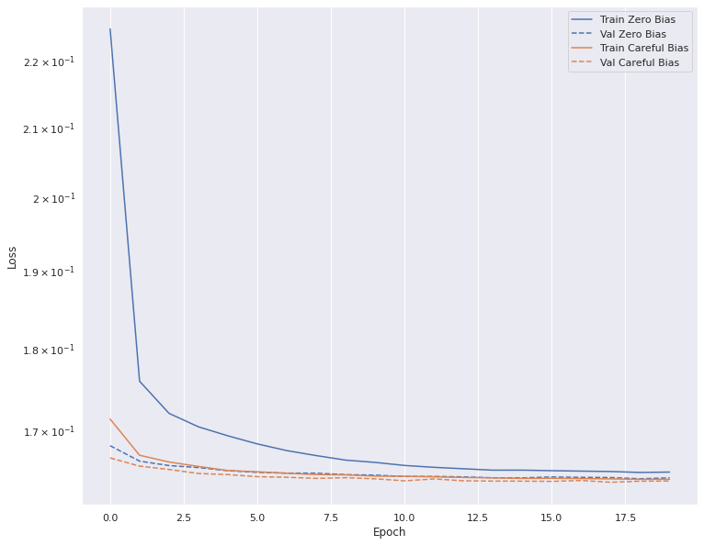
Solution #1: Logistic Regression on Browsing Data
Setting initial bias of the network helped the network learn faster and reduce loss.

Slide 27
Solution #1: Logistic Regression on Browsing Data
Results
MAP@10 = 0.00061
Baseline = 0.00051
Slight improvement - but nothing groundbreaking

Slide 28
Solution #2: Cosine Similarity with Collaborative Filtering
This method computes the cosine similarity between coupons the user has bought with coupons in the test set. This solution is memory-based, not model-based
Comparison Fields: ['discount_rate', 'discount_price', 'capsule_text', 'genre', 'large_area', 'small_area', 'coupon_prefecture', 'age_group', 'sex', 'user_prefecture']
Merge user data with test coupons
One-hot encoding
Return 10 max similarity
For every coupon a user has purchased, create a comparison vector containing that coupon’s data and the user’s metadata (age_group, sex, prefecture). Also compute a matrix of all 310 test coupons.
One-hot encode all the categorical variables in the “purchased” coupon and the test coupon matrix.
Compute cosine similarities between all 310 coupons and all n coupons a user has purchased. Select the 10 coupons with the highest similarity score to any coupon the user bought in the past.

Slide 29
Solution #2: Cosine Similarity with Collaborative Filtering
Results (scored by Kaggle on held-out test data)
Cosine Similarity Hybrid CF = 0.00269 Wow! (Top 73%)
Class-Weighted Logistic Regression = 0.00061
Baseline (Random Sampling) = 0.00051
Logistic Regression (Unweighted) = 0.00028
Cosine similarity using a user’s actual purchases is an order of magnitude better than trying to use browsing history to predict purchases.
However - if a user has never purchased anything, this algorithm predicts nothing for them - maybe we can backfill it with predictions based on browser history!

Slide 30
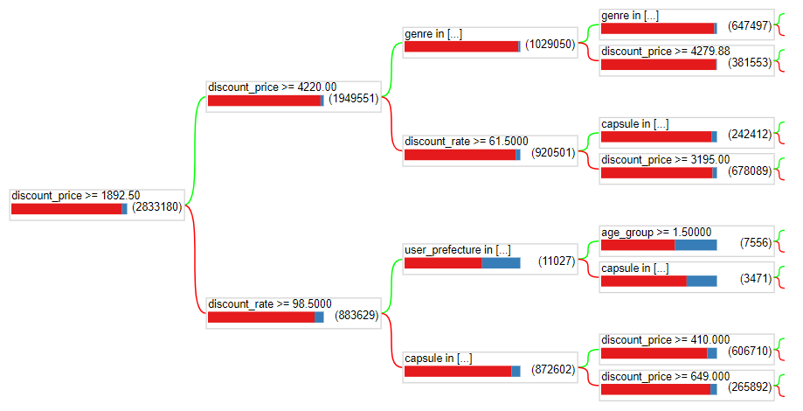
Solution #3a: Decision Forest (TFDF)
Trained on the same unbalanced browsing data as logistic regression
MAP@10: 0.00047
Baseline: 0.00051
Decision trees are weak classifiers and are usually outperformed by gradient boosted trees.¹
1. Gradient Boosting (Wikipedia) https://en.wikipedia.org/wiki/Gradient_boosting

Slide 31
Solution #3b: Gradient Boosted Trees (TFDF)
Trained on the same unbalanced browsing data as logistic regression
MAP@10: 0.00263 (!) Similar performance as cosine similarity on purchase history!!
Baseline: 0.00051
ds_train_set = tfdf.keras.pd_dataframe_to_tf_dataset(df_train, label='purchased')
model = tfdf.keras.GradientBoostedTreesModel(
num_trees=500, growing_strategy='BEST_FIRST_GLOBAL', max_depth=8,
split_axis='SPARSE_OBLIQUE')
model.fit(ds_train_set)

Slide 32
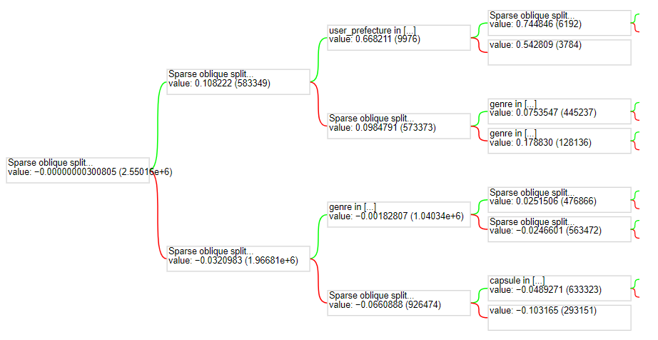
Gradient Boosted Tree Plot

Slide 33
Results

Slide 34
Solution Comparison Matrix
Baseline MAP@10 score on Random Sampled submission: 0.00051
 | Logistic Regression | Logistic Regression with Class Weights | Cosine Similarity | Decision Forest | Gradient Boosted Decision Trees
Details | No Class Imbalance Correction | Corrected for class imbalance | no backfilling | Using TensorFlow Decision Forests (Random Forest and CART) | TF-DF Gradient Boosted Trees with hyperparameters: 500 trees Best First Global growing strategy Max depth 8 Sparse Oblique split axis
MAP@10 Kaggle Public | 0.00028 | 0.00061 | 0.00269 | 0.00047 | 0.00263
Pros | Easy to configure Prediction column exists for training | Easy to configure Optimized for class imbalance | Best performance thus far (top 73%) | Easy to code No preprocessing necessary | Easy to code No preprocessing necessary Great performance
Cons | It’s terrible Training and inference time > 2hr | Still not very accurate compared to other solutions | Extremely long inference time Computationally expensive No results for users who don’t buy anything | Worse than baseline (needs HP tuning?) | Maybe *too* easy… :)

Slide 35
New Work Since Our Presentation
Baseline MAP@10 score on Random Sampled submission: 0.00051
We took the Cosine Similarity submission and found 91 users without assigned coupons. This is because those users had no purchase history to predict from.
Then, we used the Gradient Boosted Trees predictions for those users (based on browsing history) and assigned those coupons to them for the submission.
This resulted in the best score of all attempts, but with ~22K users, the improvement was small.
Result: MAP@10 = 0.00283 (public), 0.00336 (private)

Slide 36
Conclusions
Initial conclusions:
Browsing history has less-than-expected correlation with purchasing habits
Past purchasing habits are better indicators of future purchases
Cosine Similarity on purchase data far outperforms Logistic Regression (as a binary classifier) on browsing data
HOWEVER:
Gradient Boosted Trees performs at the same level as cosine similarity, though they are trained on browsing data. This merits further investigation.

Slide 37
Future Enhancements
To be completed by project deadline:
Include cosine similarity with backfilling based on browsing history (maximize MAP to predict for users without purchase history) (Completed)
Aspirational goals:
If a user has not browsed anything, include coupons for similar demographic
Tune hyperparameters for gradient boosting
Experiment with different dataset selection techniques
EDA and training for coupon area table (more location-aware predictions)
Aim for public MAP@10 score on test set > 0.008 (top 100 / top 10%)
Create time machine to back in time and win $50,000

Slide 38
Thank You!
Q&A

Slide 39
Appendix

Slide 40
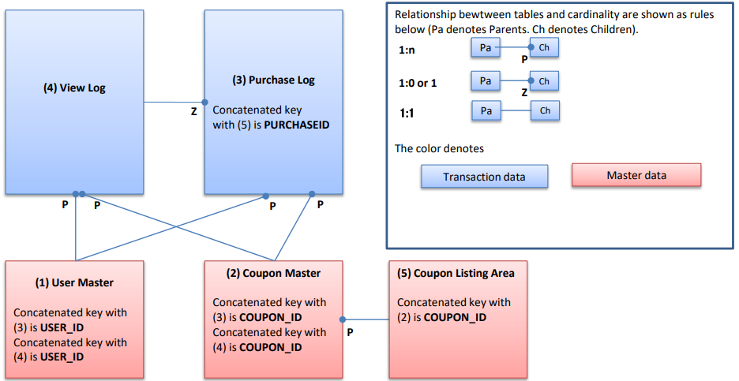
Entity Relationship Diagram
Source: Provided with the Kaggle competition documentation

